Slide 1
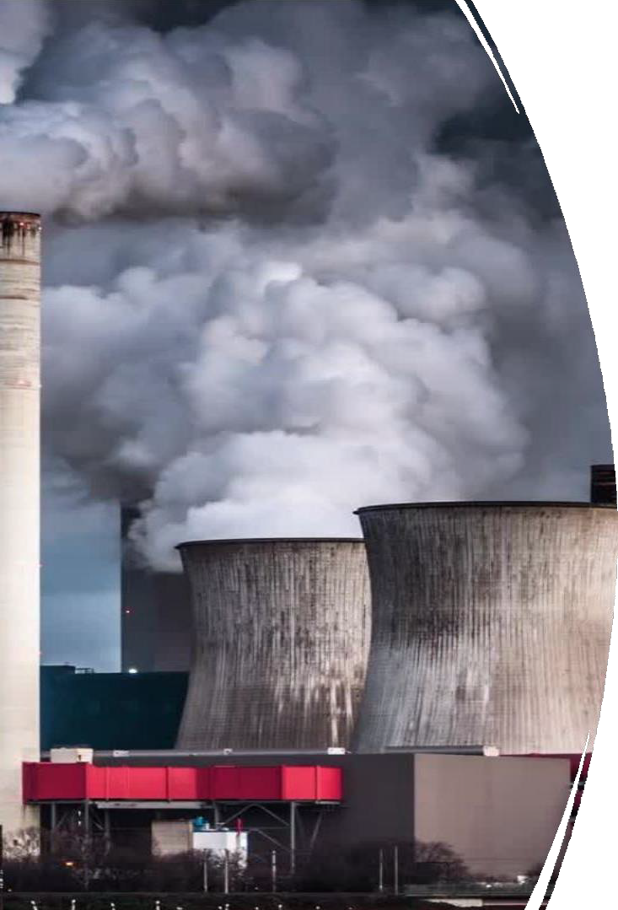
Air Pollution: Sources, Impacts, Preventive Measures, and Public Health Aspects
A comprehensive look at air pollution and
its effects on the environment and health
1. 1RN22AI042-
GAURAV ADITYA
INTRODUCTION,MAIN ASPECTS,TYPES OF POLLUTANT
2.1RN22AI020- SHREYAS BP
IMPACTS ON HUMAN HEALTH,IMPACTS ON ENVIRONMENT
3.1RN22AI014- ANANYA SHREE KR
VULNERABLE POPULATION,PREVENTIVE MEASURES,PUBLIC HEALTH ASPECTS
4.1RN22AI040-
DISHA HY
ROLE OF TECHNOLOGY IN REDUCING AIR POLLUTION,CONCLUSION

Slide 2

Introduction to Air Pollution
Air pollution refers to harmful substances released into the atmosphere, which harm human health, ecosystems, and contribute to climate change. Understanding sources, impacts, and preventive measures is crucial to mitigate its effects.

Slide 3
Natural Sources: Volcanic eruptions, wildfires, and dust storms release particulate matter and gases into the air.
Human-Made Sources : Buildings,
vehicles , etc.
Transportation: Vehicle emissions are major sources of nitrogen oxides and carbon monoxide.
Industry: Factories release pollutants like sulfur dioxide and volatile organic compounds.
Agriculture: Livestock and fertilizers emit methane and ammonia.
Residential: Indoor sources like cooking and heating contribute to indoor air pollution.
Main Sources of Air Pollution

Slide 4
Nitrogen Oxides (NOx): Released from vehicles and industry, contributing to respiratory problems and smog.
Particulate Matter (PM2.5 and PM10): Tiny particles that can penetrate respiratory systems and cause health issues.
Types of Air Pollutants
Sulfur Dioxide (SO2): Produced by fossil fuel
combustion, it can cause acid rain.
Carbon Monoxide (CO): A colorless, odorless gas
from burning fossil fuels, harmful at high levels.
Ozone (O3): At ground level, it's a harmful pollutant contributing to respiratory issues.
Lead and Heavy Metals: Released from industrial
sources, these can cause neurological problems.

Slide 5


Damage to Ecosystems: Pollutants affect soil, water, and biodiversity.
Climate Change: Greenhouse gases contribute to global warming and weather pattern shifts.
Impacts on the Environment
Acid Rain: SO2 and NOx emissions lead to acid rain, damaging forests and waterways.
Ozone Layer Depletion: Certain pollutants degrade the ozone layer, increasing UV radiation.

Slide 6


Respiratory
Issues: Increased asthma, bronchitis, and other lung diseases due to air pollutants.
Cardiovascular Problems: Air pollution is linked to heart
disease, hypertension, and stroke.
Impacts on Human Health
Cancer Risk: Long-term exposure to pollutants
increases the risk of certain cancers.
Premature
Death: Poor air quality contributes to premature mortality worldwide.

Slide 7
Children: More susceptible to respiratory issues due to developing lungs.
Low-Income Communities: Often located near pollution sources, facing greater health risks.
Vulnerable Populations
Elderly: Increased risk of health complications from chronic exposure.
Pregnant Women: Exposure can impact fetal development.

Slide 8

Preventive Measures
Cleaner Industry Practices: Reducing emissions with cleaner technology and waste management.
Individual Actions: Using public transport, energy- efficient appliances, and reducing waste.
Government Regulations: Policies like Clean Air Acts enforce emission standards.
Renewable Energy: Shift to wind, solar, and other green energy sources to reduce pollution.

Slide 9



Public Health Aspects
Air Quality Monitoring: Tracking pollution levels helps issue health advisories.
Public Health Campaigns: Educating the public on air quality and protective measures.
Health Guidelines: Organizations like WHO set standards
to protect populations.
Research and Innovation: Advancements in reducing
pollution exposure for improved health outcomes.

Slide 10
Role of Technology in Reducing Air Pollution
Renewable Energy Sources: Solar and wind power reduce reliance on fossil fuels.
•Air Filtration Systems: Improve indoor air quality by filtering out pollutants.
Electric Vehicles (EVs) : Reduce emissions compared to gasoline- powered vehicles.
Carbon Capture: Technology to capture CO2 emissions from industrial processes.

Slide 11
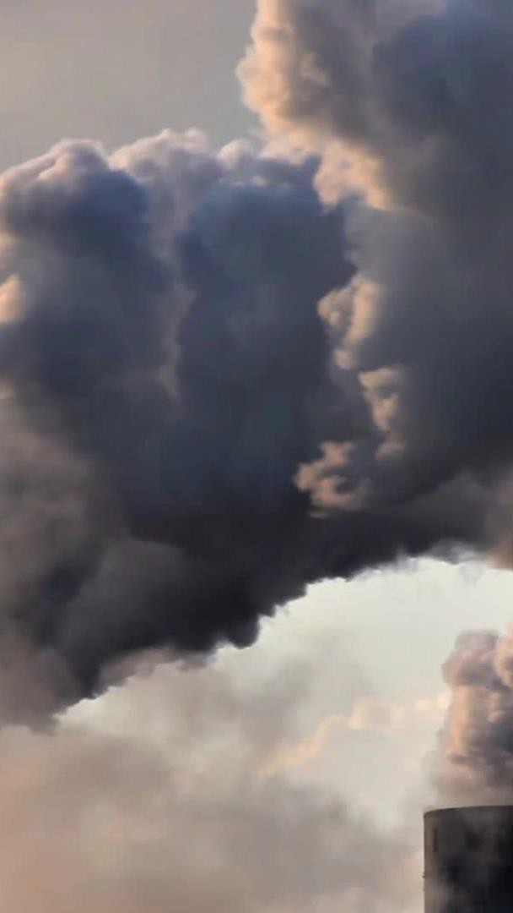
Conclusion
Air pollution presents a global challenge, affecting health and the environment. Collective efforts from individuals, governments, and industries are essential to reduce its impacts and ensure a healthier, more sustainable future.

Slide 12
• World Health Organization (WHO)
• Environmental Protection Agency (EPA)
• National Geographic, Air Pollution Overview
• Scientific Journals and Articles on Environmental Science
References

